Slide 1
Secure your development pipeline
James Pether Sörling
www.hack23.com
https://github.com/pethers
https://www.linkedin.com/in/james-pether-sörling-41194218/

Slide 2
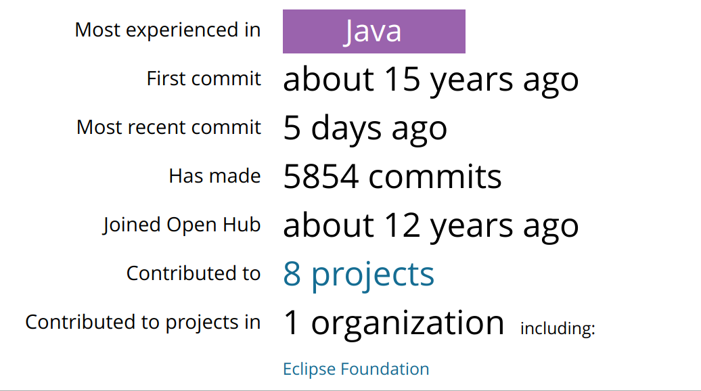
About me: Open source
https://www.openhub.net/accounts/pether

Slide 3
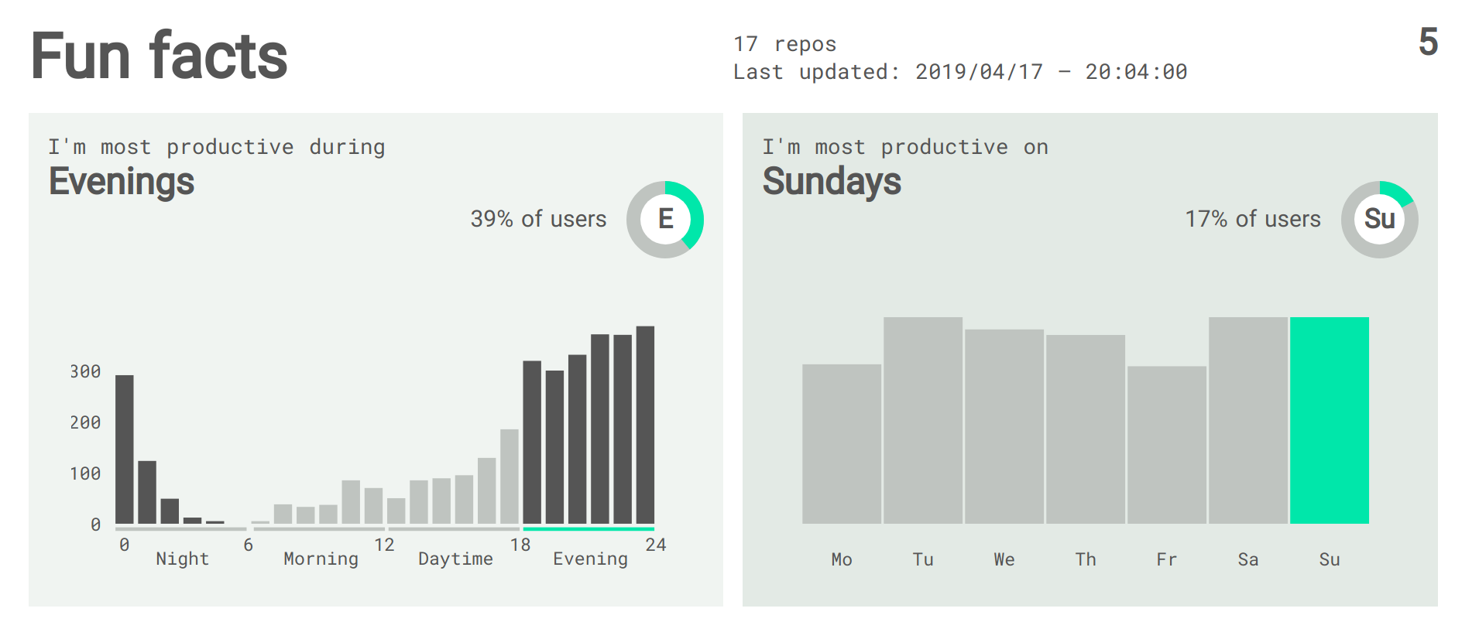
About me: Open source
https://sourcerer.io/pethers

Slide 4






About me: Preferences

Slide 5

About me : Work
Experience from development, security and operations.
20+ years java
10+ years aws
Currently : Security architect https://www.wirelesscar.com
Working with security and compliance in the cloud.

Slide 6
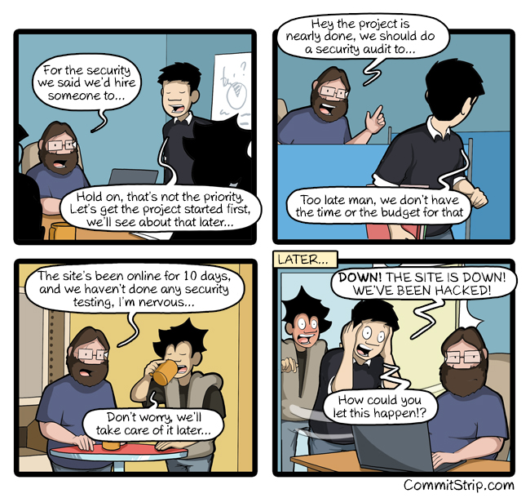
Intro: Why

Slide 7
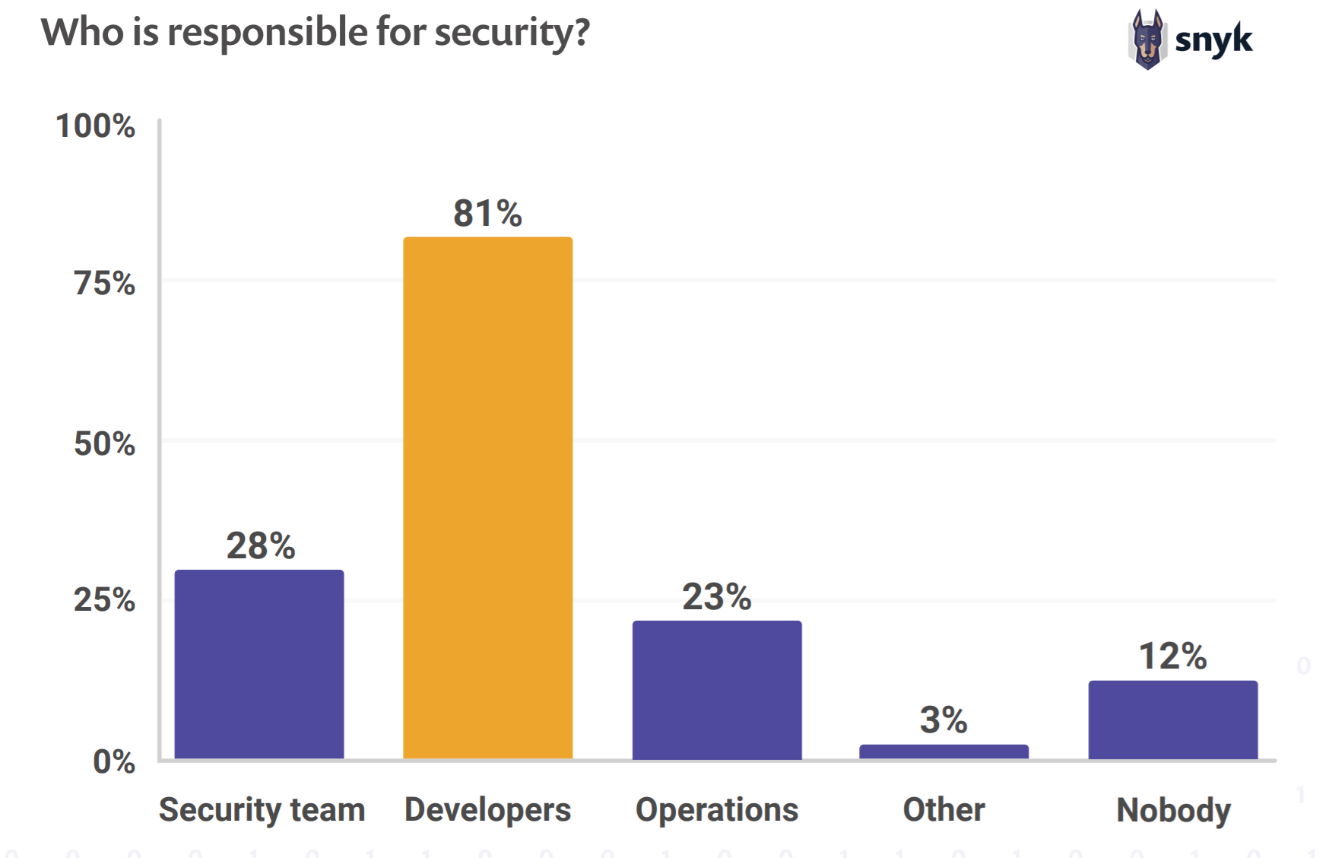
Intro:Who
The-State-Of-Open-Source-Security-Report-2019-Snyk.pdf

Slide 8
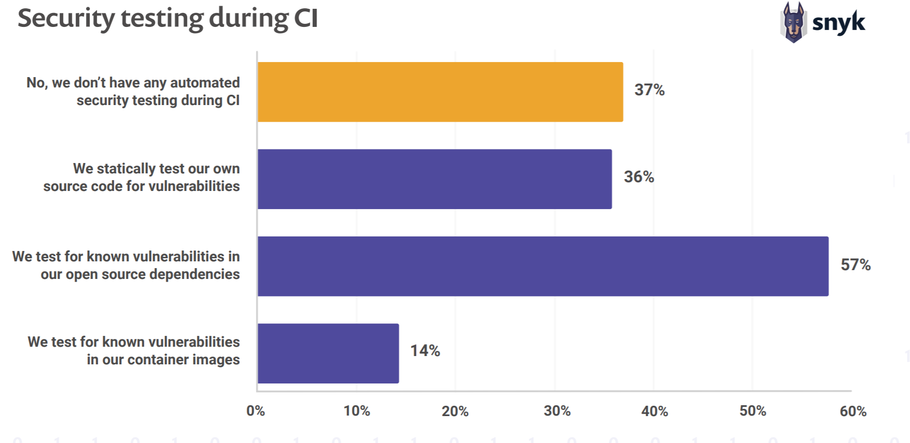
Intro: How
Missing: We dynamically test our running application for vulnerabilities
The-State-Of-Open-Source-Security-Report-2019-Snyk.pdf

Slide 9
Intro: Agenda
Tracking bugs
DevSecOps
Security testing
Secure development pipeline
Sonarqube
Demo

Slide 10

Tracking bugs : Example project
Open source project "Citizen Intelligence Agency::Tracking politicians like bugs." is used for all examples.
Source 11 , Possible runtime 11, 12, 13, 14b13
Sonarqube : https://www.hack23.com/sonar/
Source: https://github.com/Hack23/cia
Demo : https://www.hack23.com/cia/ (running JDK 13)

Slide 11
Tracking bugs : How
So how do we track bugs(security) ?

Slide 12
Tracking bugs: Types of bugs
Common Weakness Enumeration (CWE) is a category system for software weaknesses and vulnerabilities.
https://cwe.mitre.org/

Slide 13
Tracking bugs: Most Dangerous Software Errors
The SANS Top 25 Most Dangerous Software Errors
https://www.sans.org/top25-software-errors/

Slide 14
Tracking bugs: Web Application Security Risks
OWASP Top 10 Most Critical Web Application Security Risks
https://www.owasp.org/index.php/Category:OWASP_Top_Ten_Project

Slide 15
Tracking bugs: Known vulnerabilities in software
Common Vulnerabilities and Exposures (CVE)
cve-NUMBER reference for publicly known security vulnerabilities classified by risk score 0-10. with 10 being the most severe.
https://nvd.nist.gov/
https://nvd.nist.gov/vuln-metrics/cvss/v3-calculator

Slide 16
Tracking bugs: Vulnerabilities without cve:s
Not all security issues covered, mainly companies and large organizations
So important to patch often.

Slide 17
DevSecOps Reference
https://alphabravo.io/wp-content/uploads/2019/09/DoD-Enterprise-DevSecOps-Reference-Design-V1.0.pdf
DoD-Enterprise-DevSecOps-Reference-Design-V1.0.pdf

Slide 18
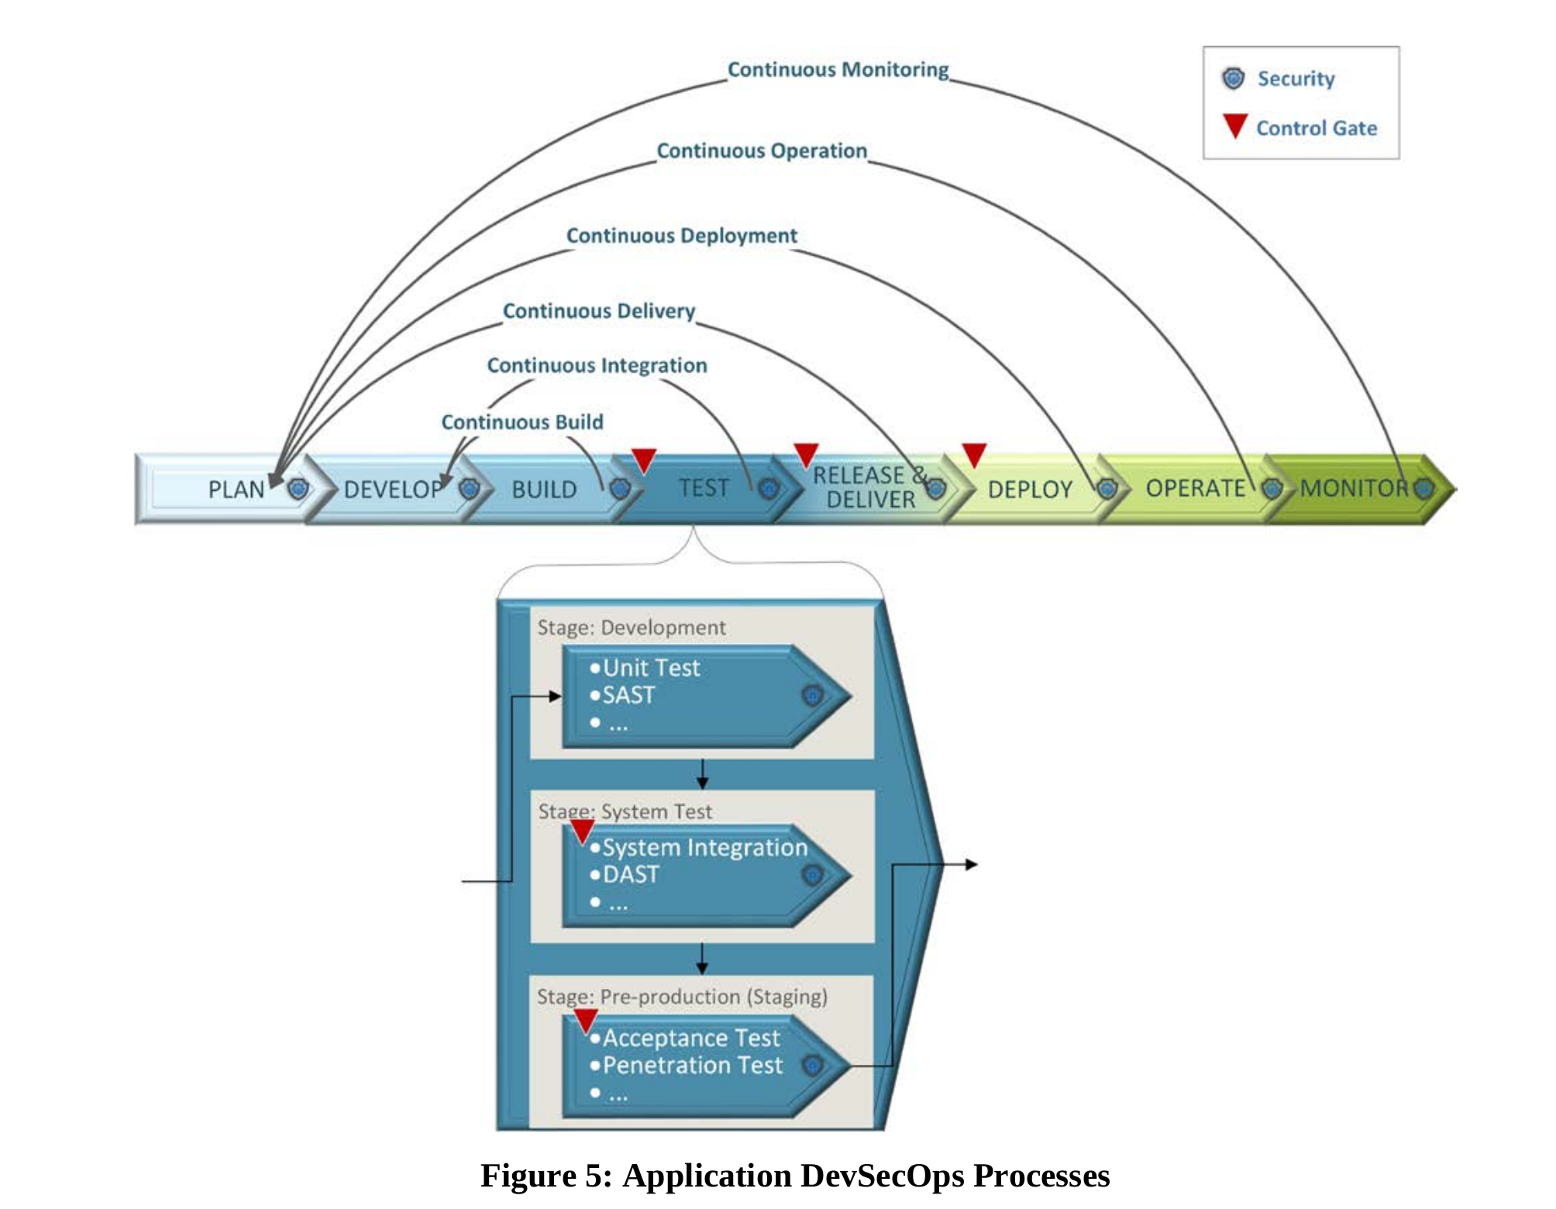
DevSecOps Processes
DoD-Enterprise-DevSecOps-Reference-Design-V1.0.pdf

Slide 19
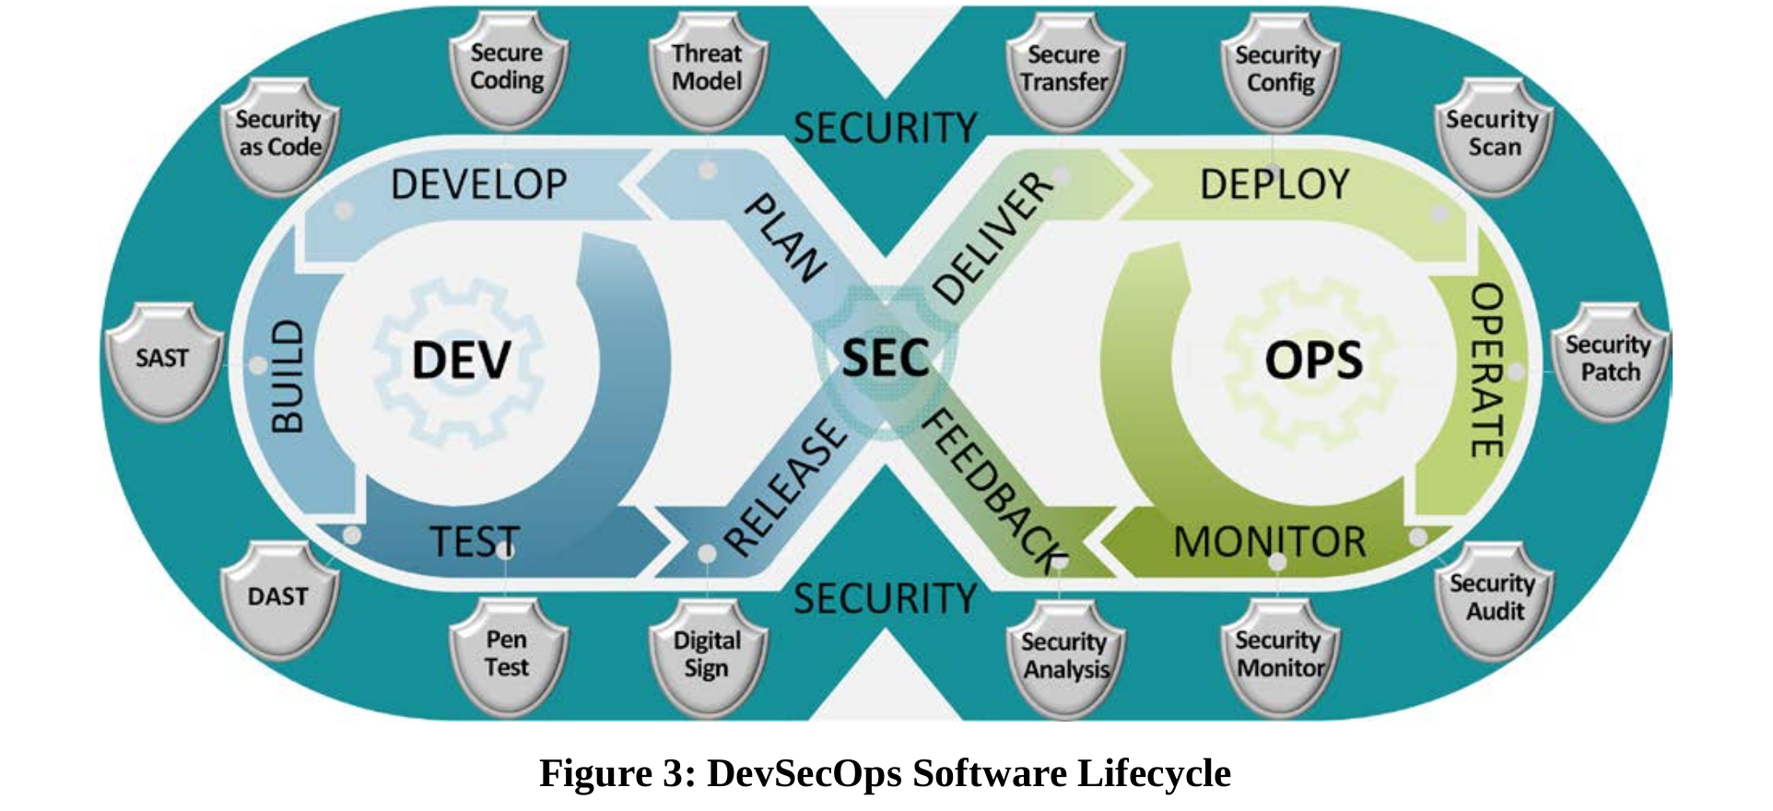
DevSecOps software lifecycle
DoD-Enterprise-DevSecOps-Reference-Design-V1.0.pdf

Slide 20
Security test : Types of security test
Static application security test(SAST) (scan code)
Software composition analysis(SCA) (scan dependencies)
Dynamic application security test(DAST) (scan applications)

Slide 21
Security test : Static application security test(SAST)
Analysis of code, so requires source code.
Do not require application to deployed/running.

Slide 22
Security test : SAST questions
How much code is in the project ?
Is the code tested ?
How much of it is tested ?
How many potential issues can be detected by the scanning code ?

Slide 23
Security test : SAST alternatives
Sonarqube
Pmd (open source)
Findbugs (open source)
Checkstyle (open source)
Checkmarx(Enterprise)
Coverity(Enterprise)
IBM Security Appscan(Enterprise)
Hosted (Free for open source)
Sonarcloud(sonarqube)
Bettercodehub
Codebeat
Lgtm
Codeclimate
Codacy
Codefactor

Slide 24
Security test :Software composition analysis(SCA)
https://www.owasp.org/index.php/Component_Analysis will cover component inventory, known vulnerabilities, outdated components and licenses
https://www.owasp.org/index.php/Component_Analysis will cover component inventory, known vulnerabilities, outdated components and licenses
Your/team code
Other peoples code

Slide 25
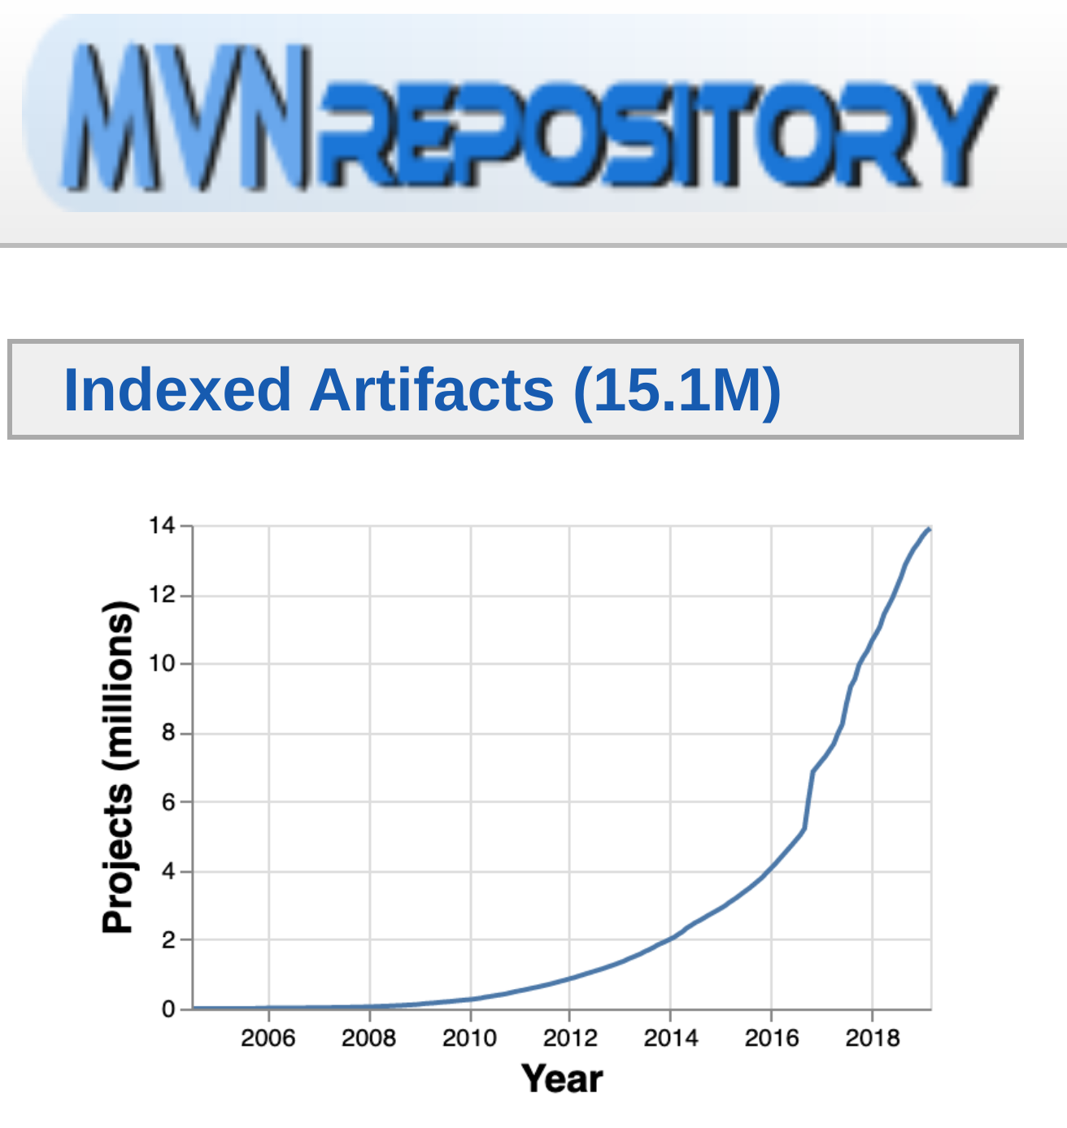
Security test : Open source dependencies(SCA)

Slide 26
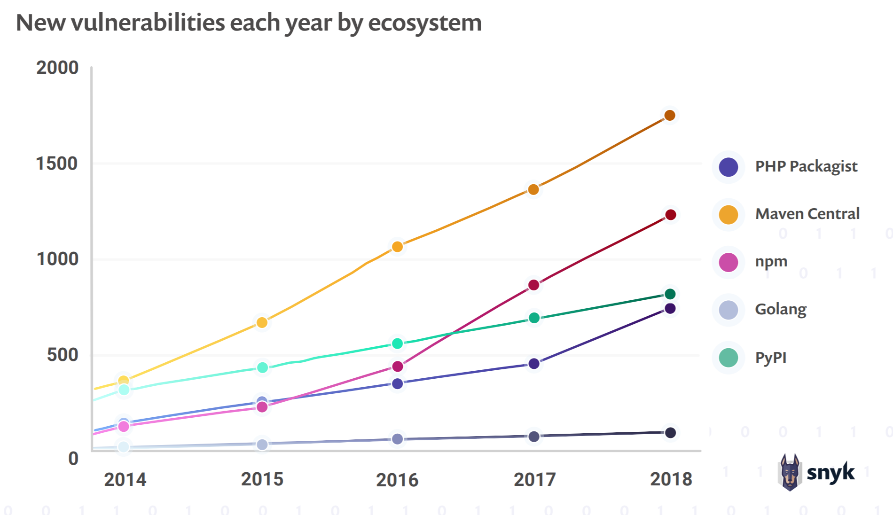
Security test : New vulnerabilities (SCA)
The-State-Of-Open-Source-Security-Report-2019-Snyk.pdf

Slide 27
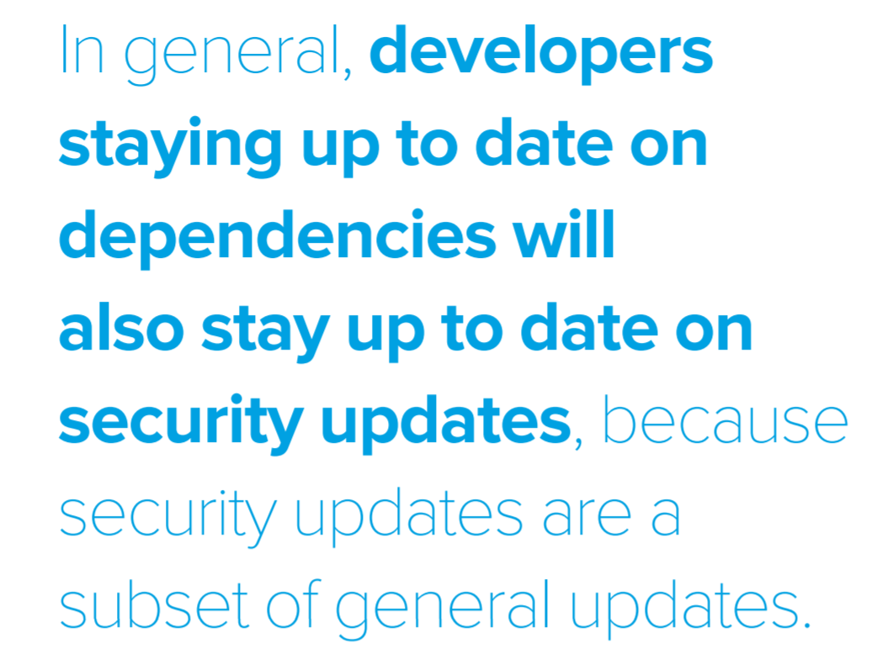
Security test : update dependencies(SCA)
https://www.sonatype.com/en-us/2019ssc

Slide 28
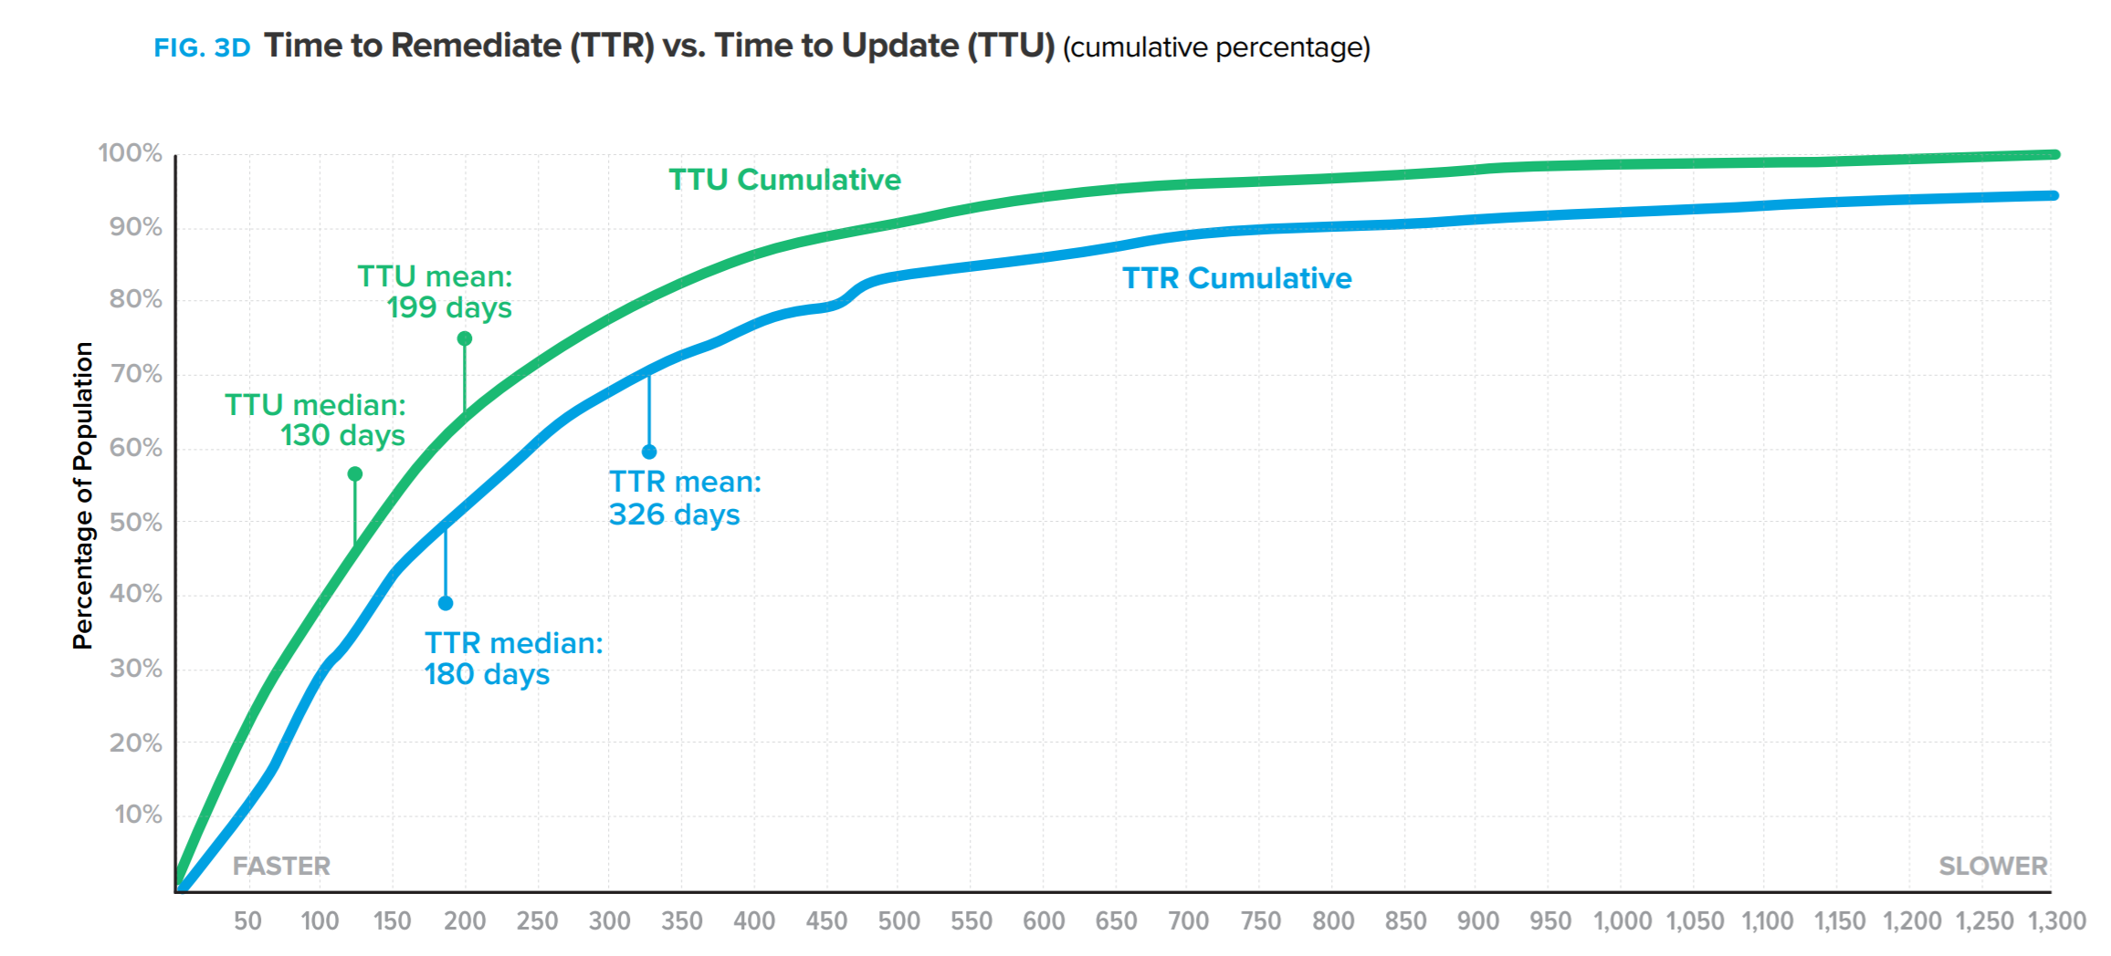
Security test : Metrics(SCA)
https://www.sonatype.com/en-us/2019ssc

Slide 29
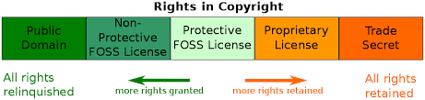
Security test : Licenses, rights in copyright (SCA)

Slide 30
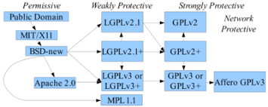
Security test : Licenses, open source licenses (SCA)

Slide 31
Security test: SCA questions
How many and which dependencies do the project have?
Are the project allowed to use all dependencies, license or compliance issues ?
Any known vulnerabilities and security risk with dependencies ?
Do the project have any stale dependencies and how outdated are they ?

Slide 32
Security test: SCA alternatives
Known vulnerabilities
Dependency-check-maven|*
Sonarqube
Snyk(commercial)
Dependa-bot(commercial)
Blackduck(commercial)
Nexus depshield(commercial)
IQServer(commercial)

Slide 33
Security test: SCA alternatives
Licenses
Sonarqube
Maven-license-plugin
FOSSA (Free for open source)
Blackduck(commercial)

Slide 34
Security test: Dynamic Application Security Testing(DAST)
Runtime analysis (active, passive scanning)
Requires deployed/running application

Slide 35
Security test: DAST alternatives
Zed attack proxy (open source)
W3AF (open source)
Arachni (open source)
Acunetix(commercial)
Detectify(commercial)
Qualys(commercial)

Slide 36
Secure build pipeline: Why Sonarqube
Open source, good record of stable releases and large community.
Plugins for many use cases
Aggregates reports in one central place
Governance: Promote transparency, Accountability, Enforce policies
Manage issues, handle false positives
Jenkins,Maven,Gradle plugins works well for a few projects

Slide 37
Secure build pipeline: Why ZAP
Easy to run and plugin available for Sonarqube
The Zed Attack Proxy (ZAP) is an OWASP project for doing Dynamic Application Security Testing (DAST) towards a web application or API.
Web: https://github.com/zaproxy/zaproxy/wiki/ZAP-Full-Scan
Api : https://github.com/zaproxy/zaproxy/wiki/ZAP-API-Scan

Slide 38
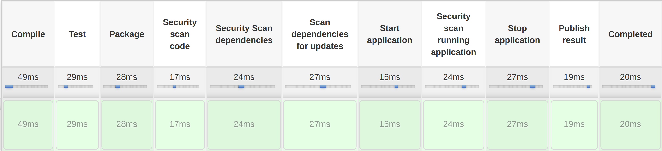
Secure build pipeline: Basic CI

Slide 39
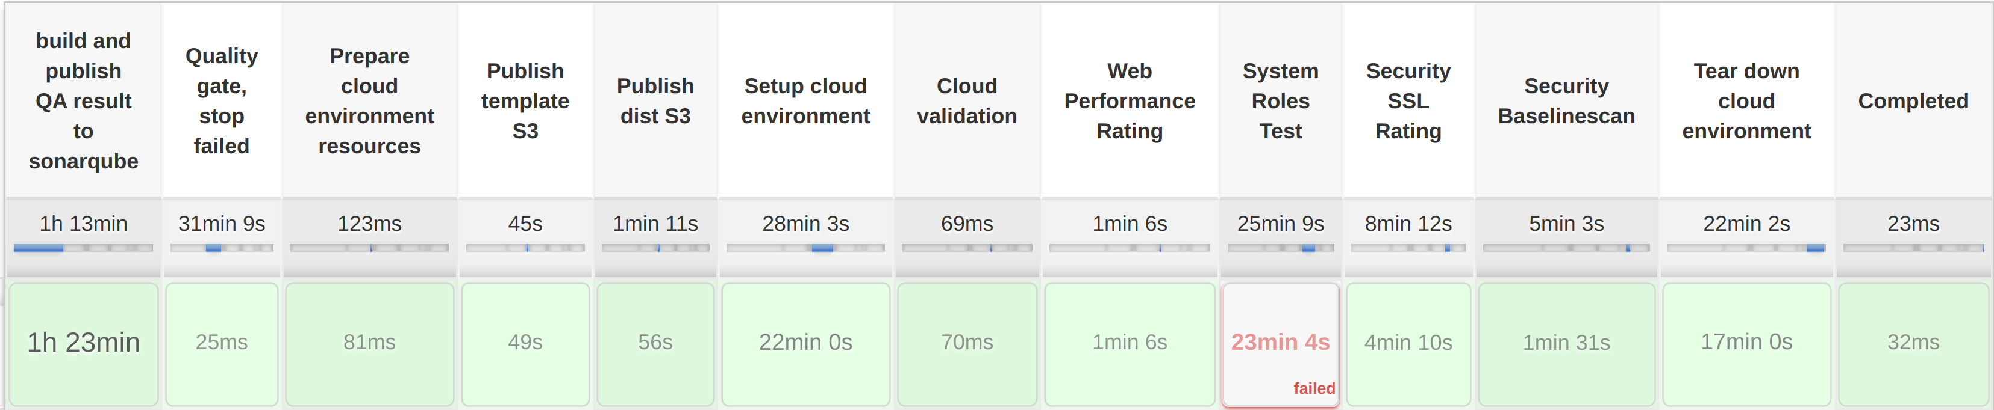
Secure development pipeline: Cloud CI
https://www.hack23.com/jenkins/view/Pipelines/job/CloudPipeline/

Slide 40
Secure development pipeline: Example maven
mvn org.jacoco:jacoco-maven-plugin:prepare-agent install
mvn org.owasp:dependency-check-maven:check
mvn org.codehaus.mojo:versions-maven-plugin:dependency-updates-report
mvn jetty:start
web: docker run -v $(pwd)/reports:/zap/wrk/:rw -t owasp/zap2docker-weekly zap-full-scan.py -t ${webURL} -j -a -x testreport.xml -r testreport.html -z "-config ajaxSpider.browserId=chrome"
api : docker run -v $(pwd)/reports:/zap/wrk/:rw -t owasp/zap2docker-weekly zap-api-scan.py -f openapi -t ${webURL} -a -x testreport.xml -r testreport.html
mvn jetty:stop
mvn org.sonarsource.scanner.maven:sonar-maven-plugin:sonar -Dsonar.dependencyCheck.reportPath=target/dependency-check-report.xml -Dsonar.dependencyCheck.htmlReportPath=target/dependency-check-report.html

Slide 41
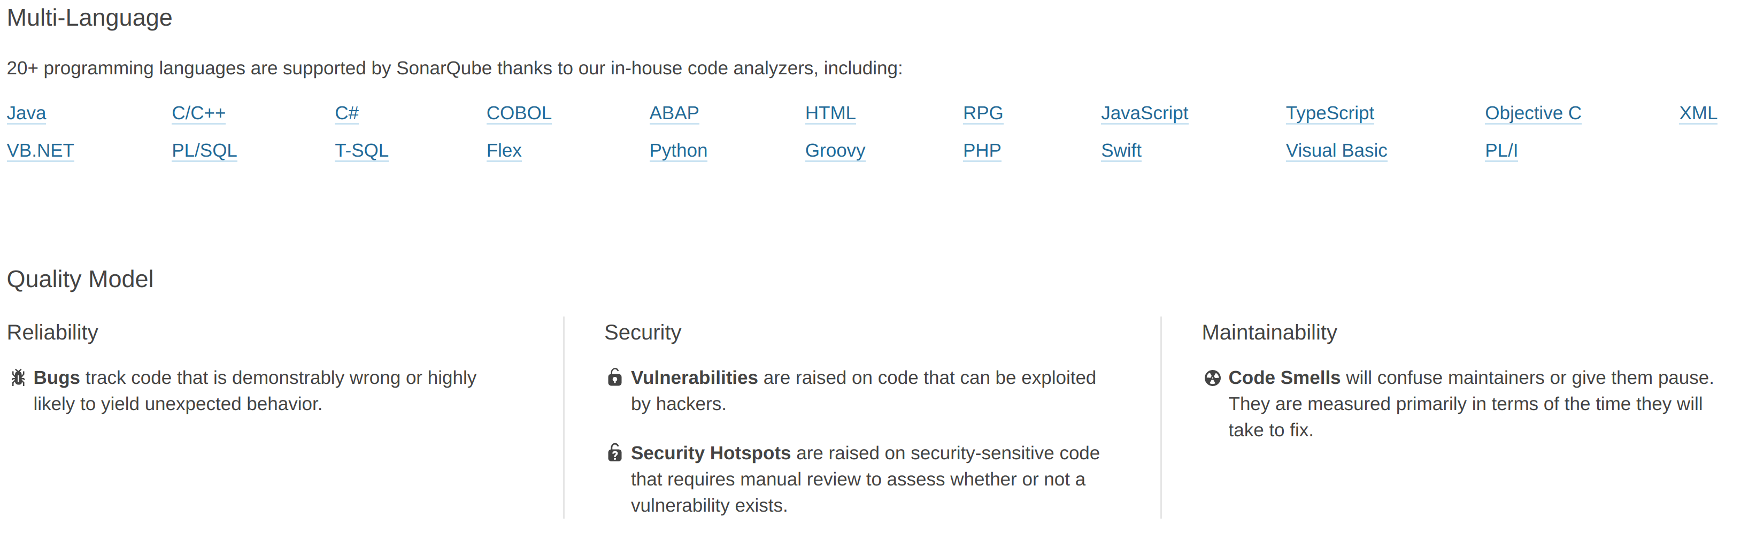
Sonarqube: intro

Slide 42
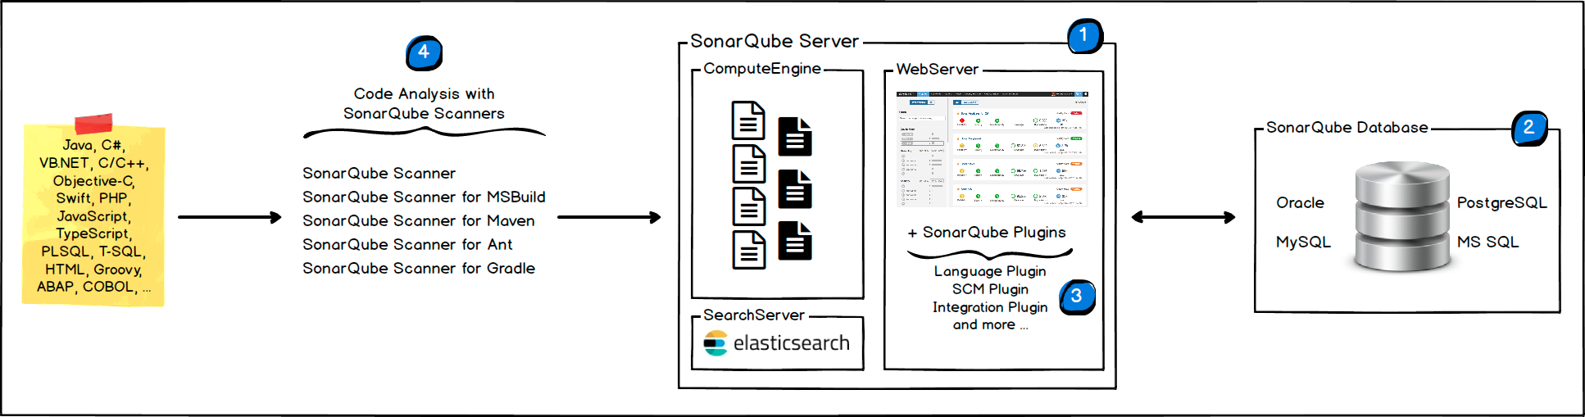
Sonarqube: Scanning

Slide 43
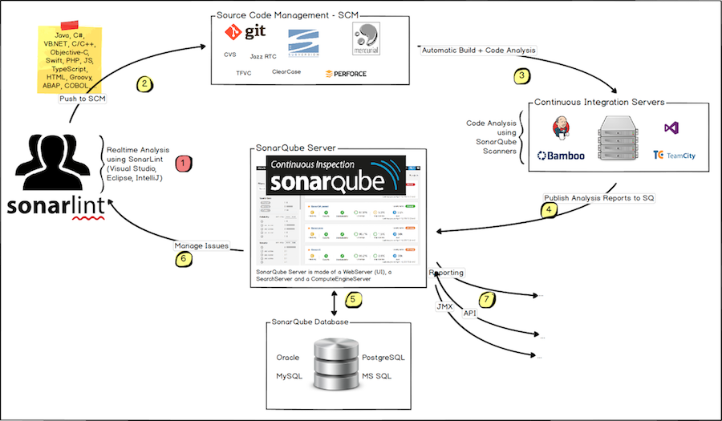
Sonarqube: Integrate

Slide 44
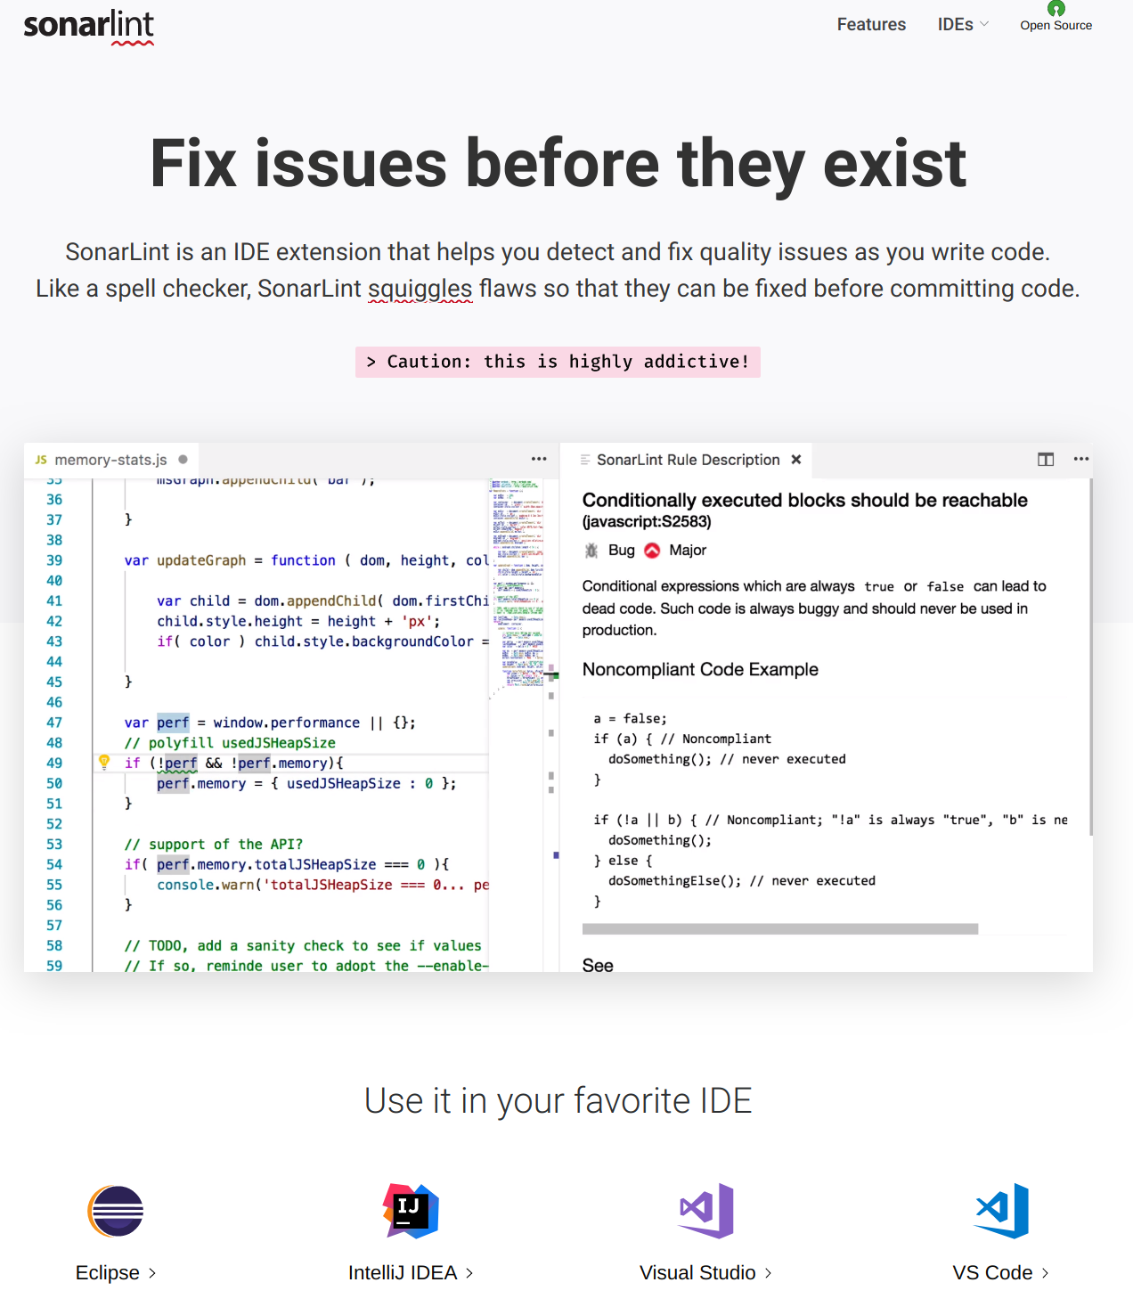
Sonarqube: IDE support

Slide 45
Sonarqube: Requirements
Server LTS 7.9.X (requires JDK11 runtime)
Scanner requires minimum JDK8 and support standalone, maven, gradle and ant.
100+ plugins with support for 25+ programming languages.

Slide 46
Sonarqube : Setup links
https://www.sonarqube.org/
https://github.com/Coveros/zap-sonar-plugin)
https://github.com/SonarSecurityCommunity/dependency-check-sonar-plugin
https://github.com/porscheinformatik/sonarqube-licensecheck
https://github.com/reallyinsane/mathan-dependency-updates-sonar-plugin

Slide 47
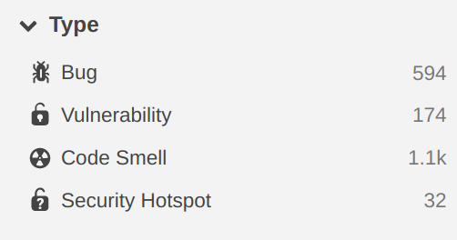
Sonarqube : Rules

Slide 48
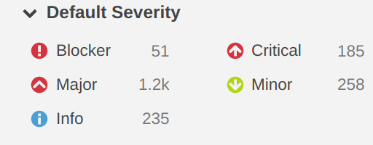
Sonarqube : Issues
Vulnerability (classified by owasp,sans, cwe,cve)
Security Hotspot (classified by owasp,sans, cwe)

Slide 49
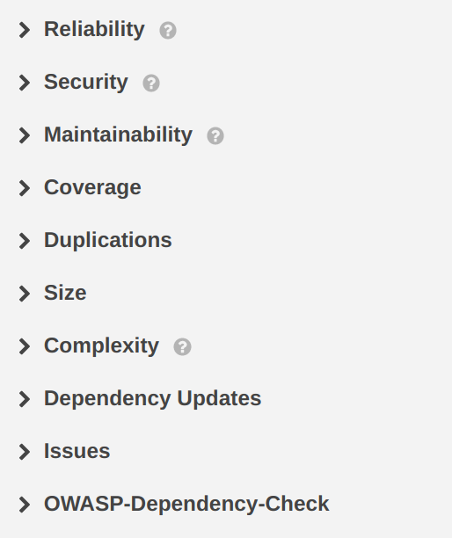
Sonarqube : Metric categories

Slide 50
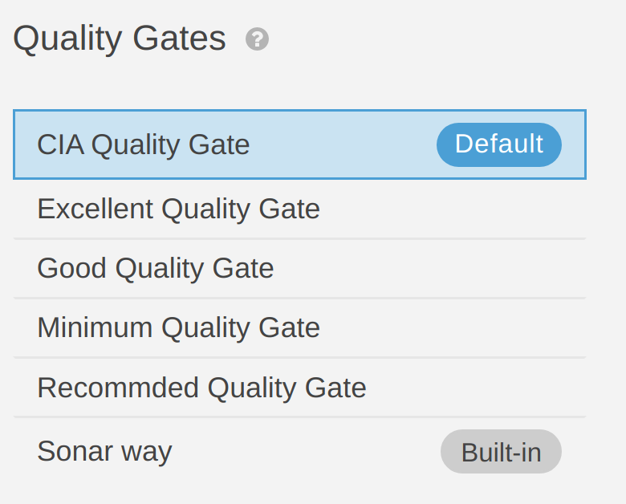
Sonarqube : Quality gates

Slide 51
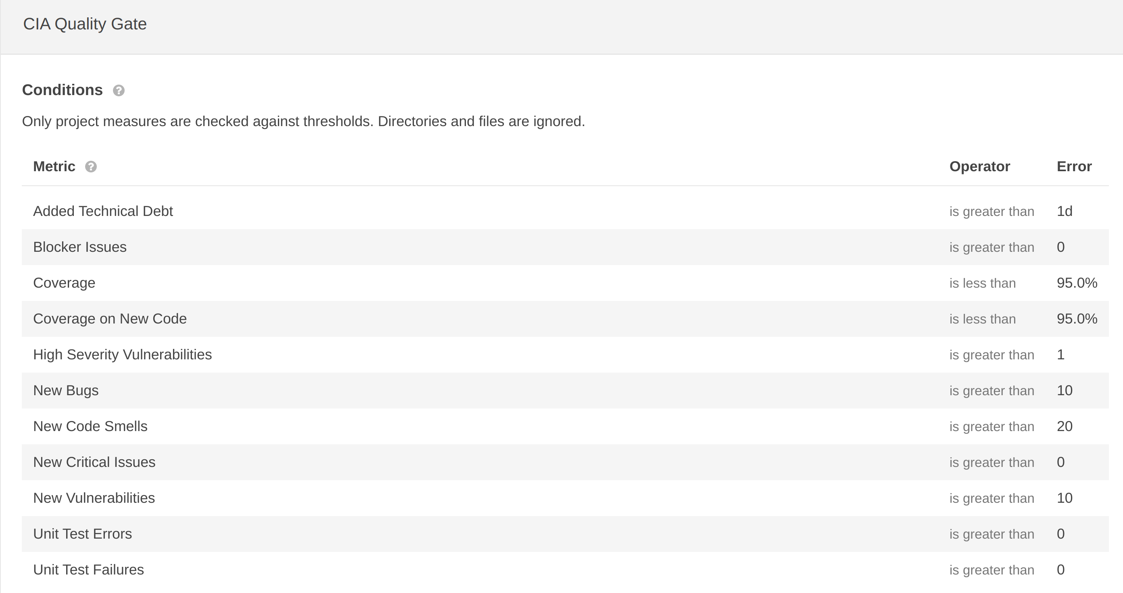
Sonarqube : Quality gates thresholds

Slide 52
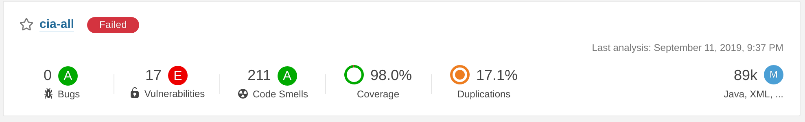
Demo: Overall status(ratings)

Slide 53
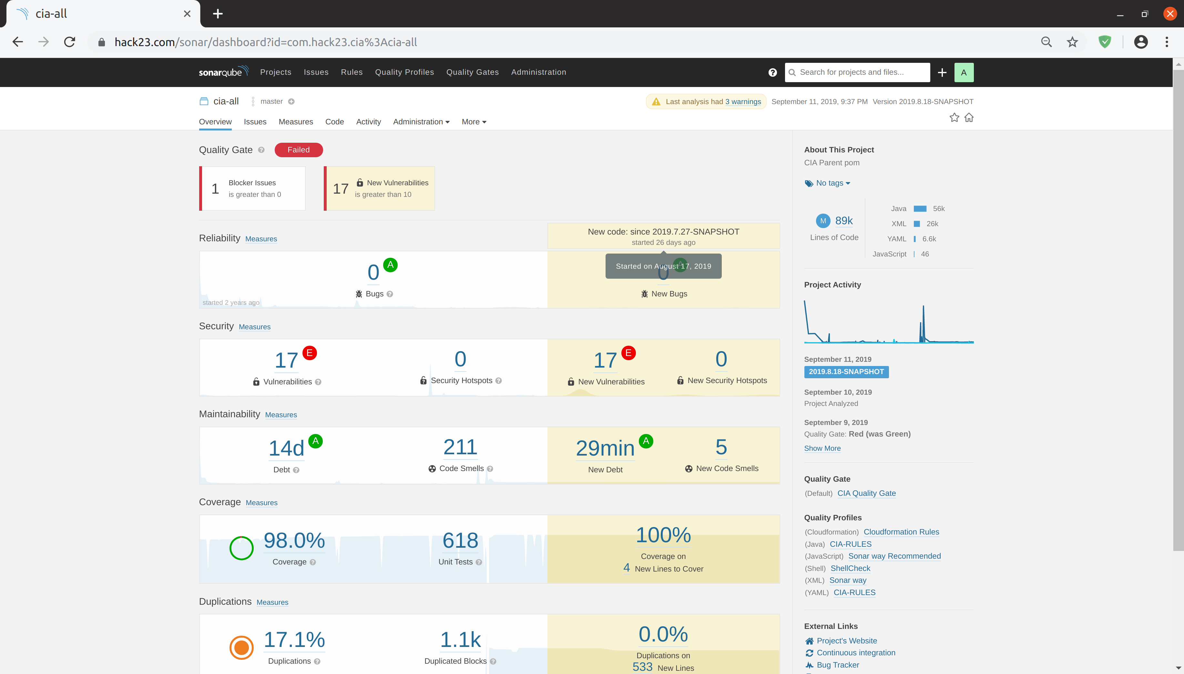
Demo : Project view

Slide 54
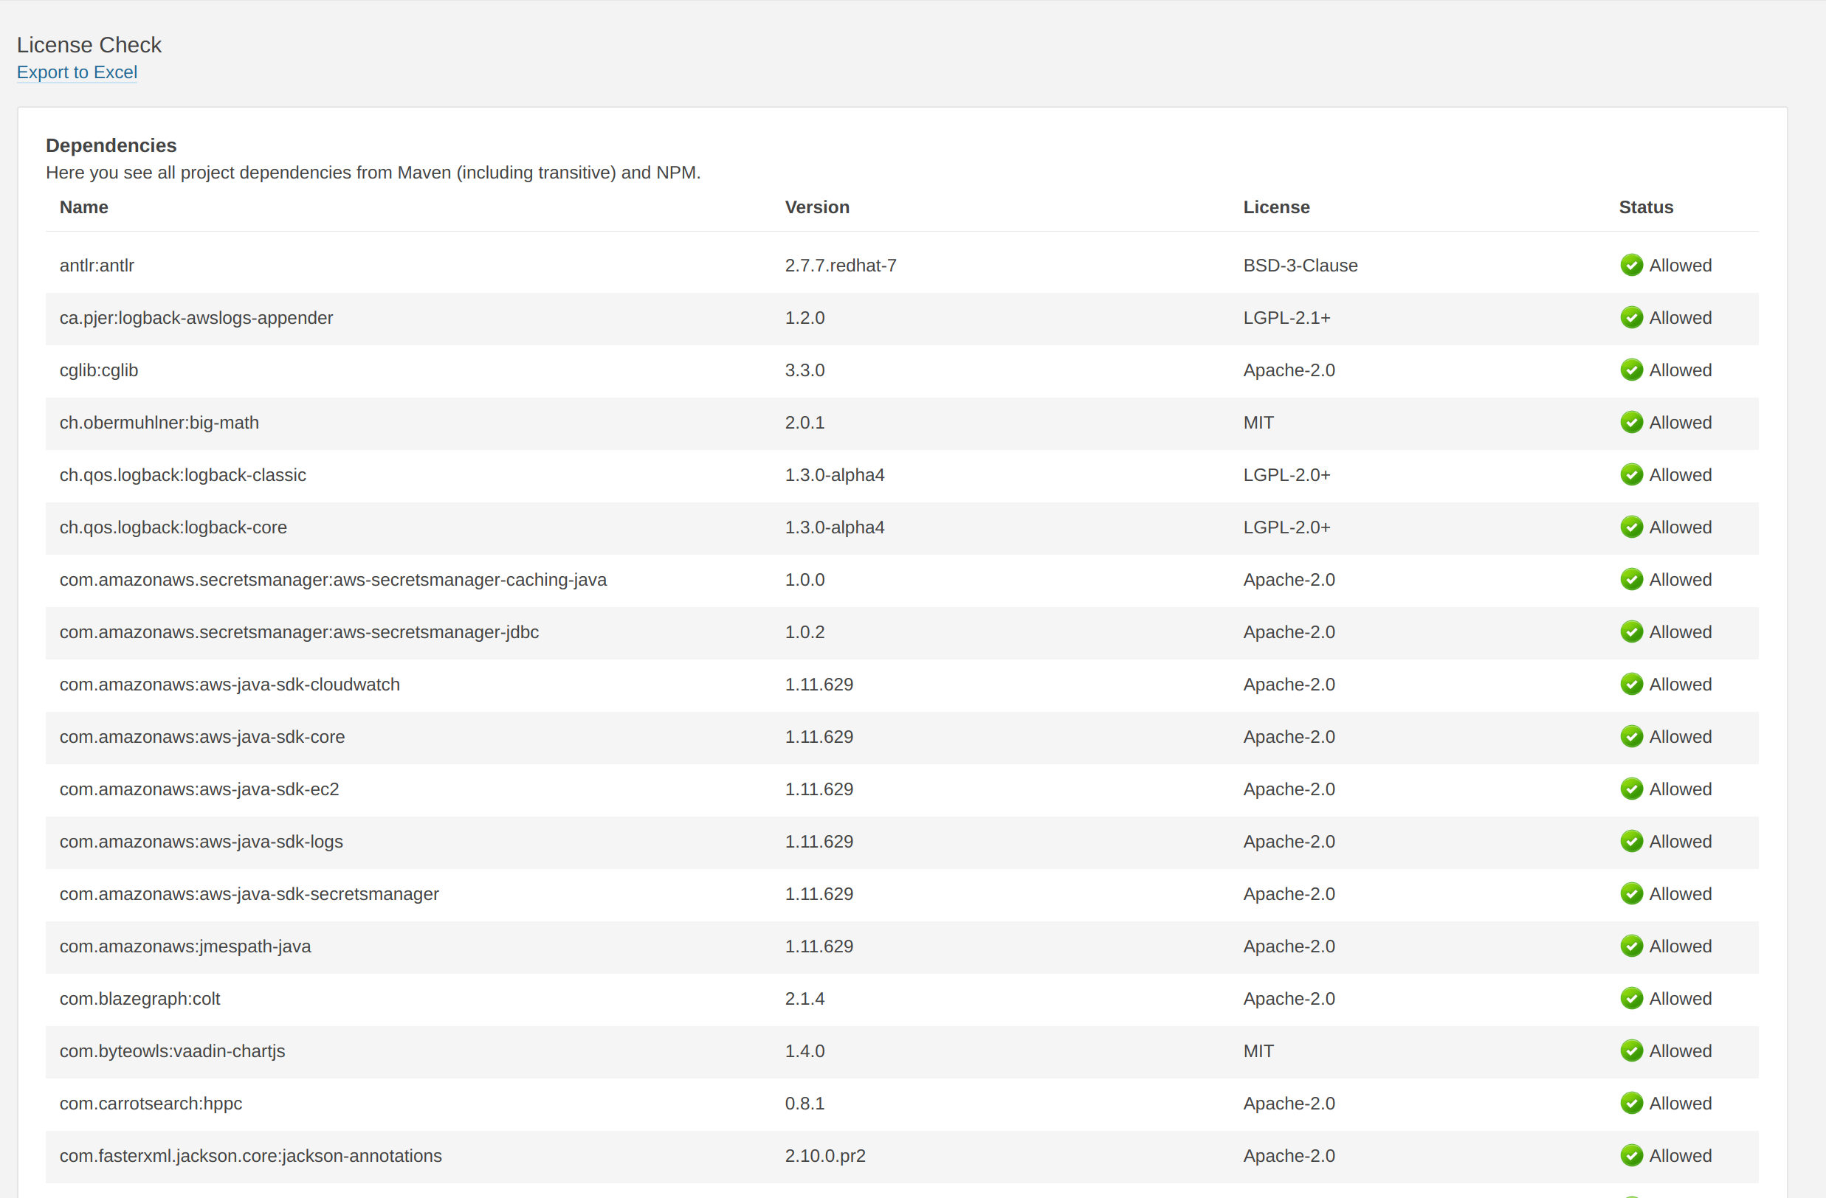
Demo : Licenses

Slide 55
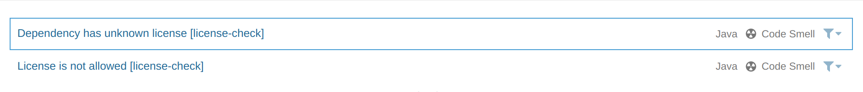
Demo : License issues
Will create issues for unknown license
Will create issues for not allowed license

Slide 56
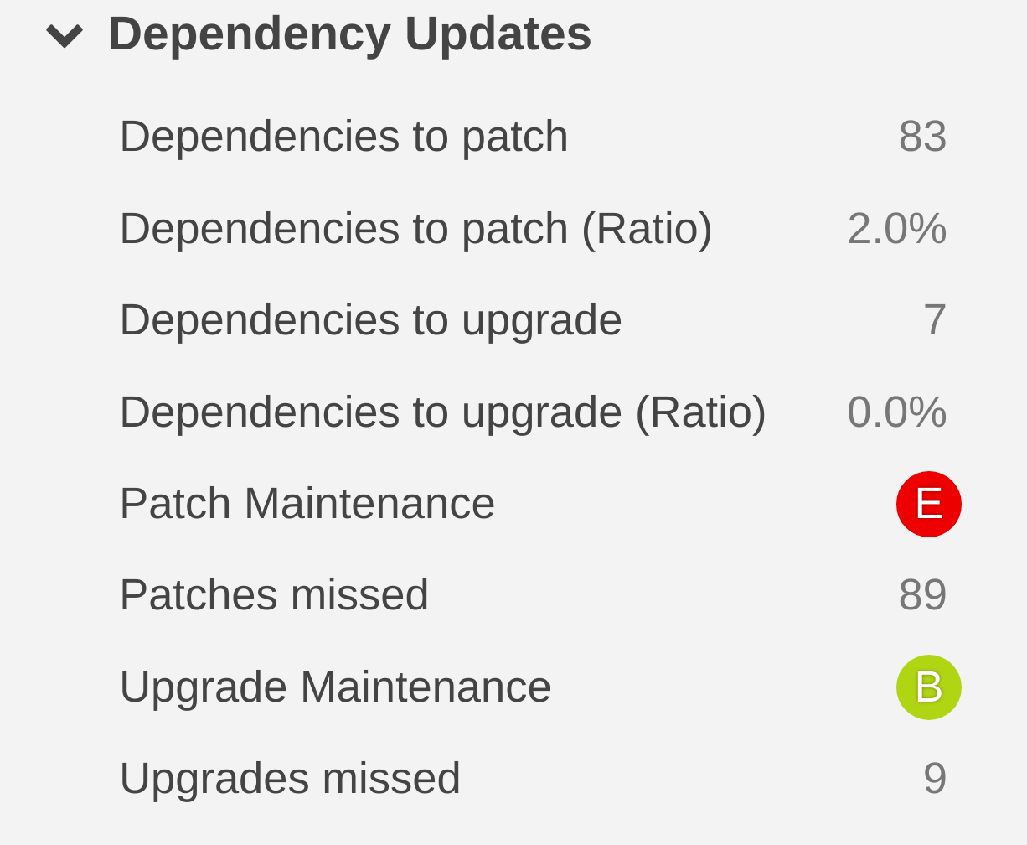
Demo: Dependency updates

Slide 57
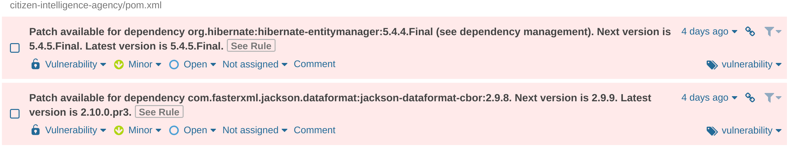
Demo: Dependency updates issues

Slide 58
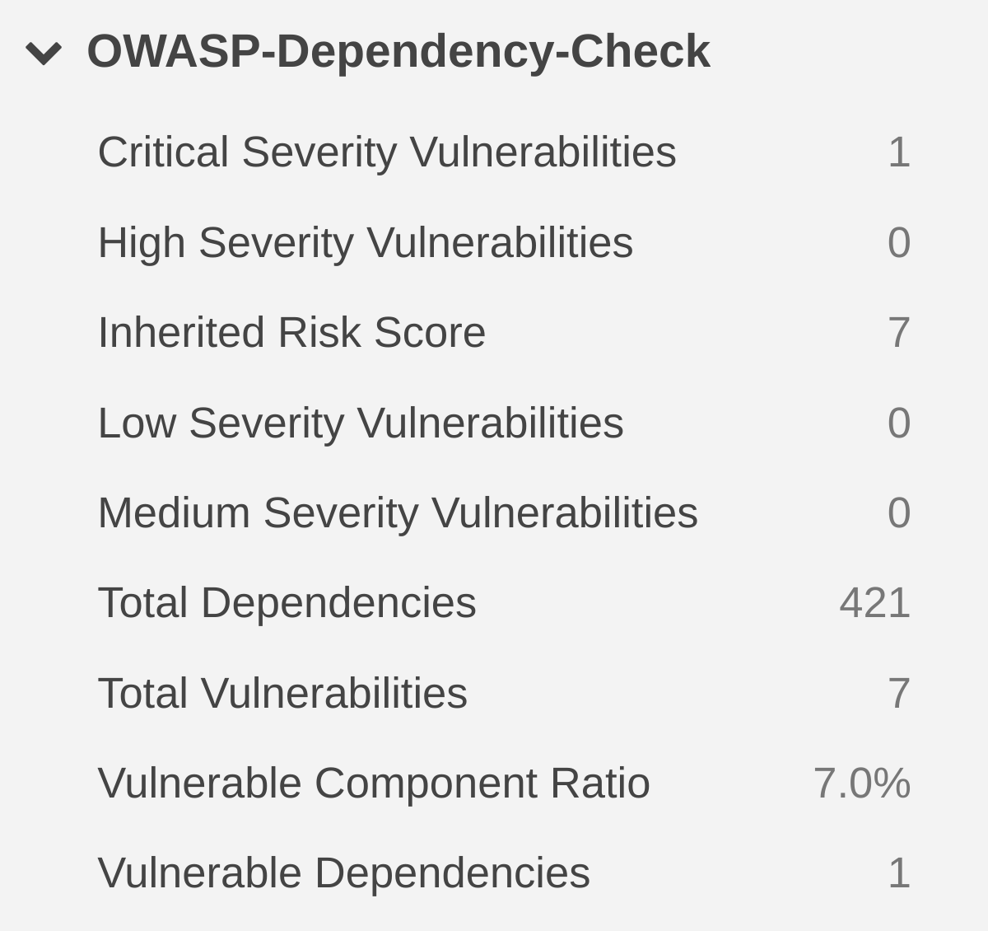
Demo: Known vulnerabilities

Slide 59
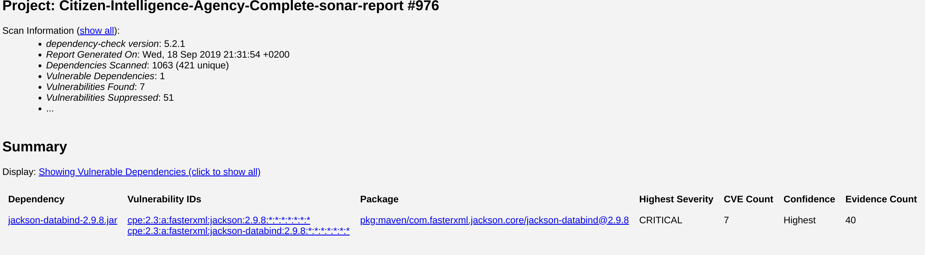
Demo: Known vulnerabilities report

Slide 60
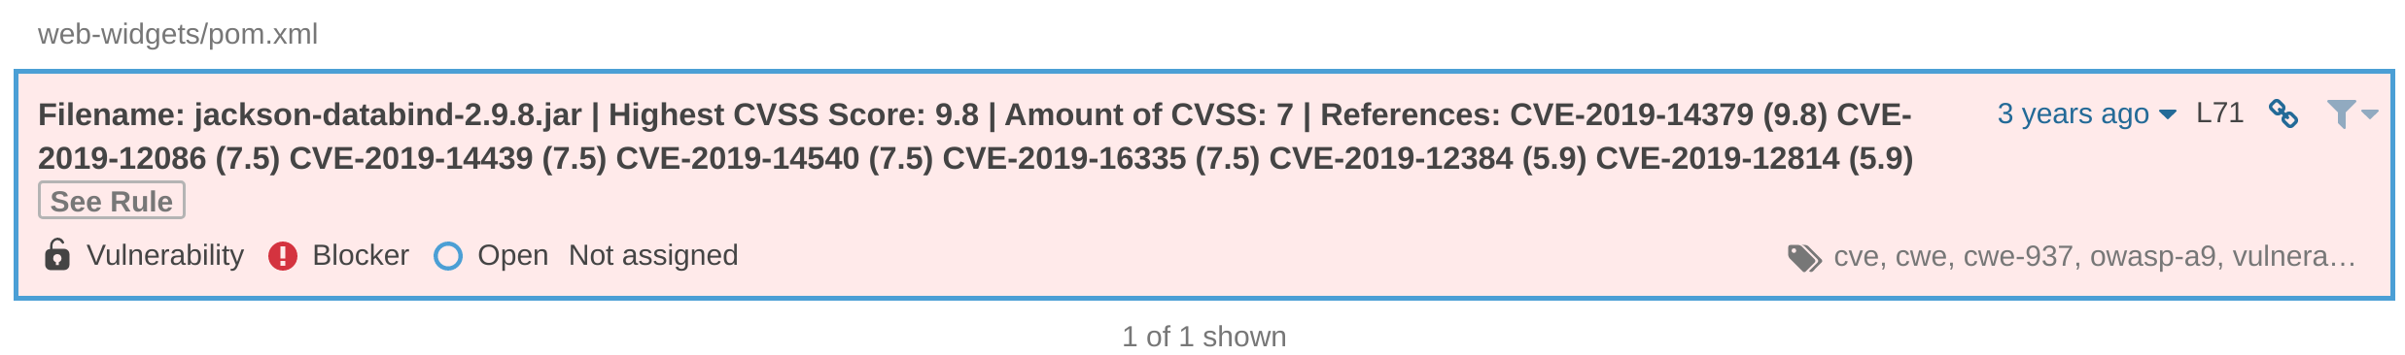
Demo : Known vulnerabilities issues

Slide 61
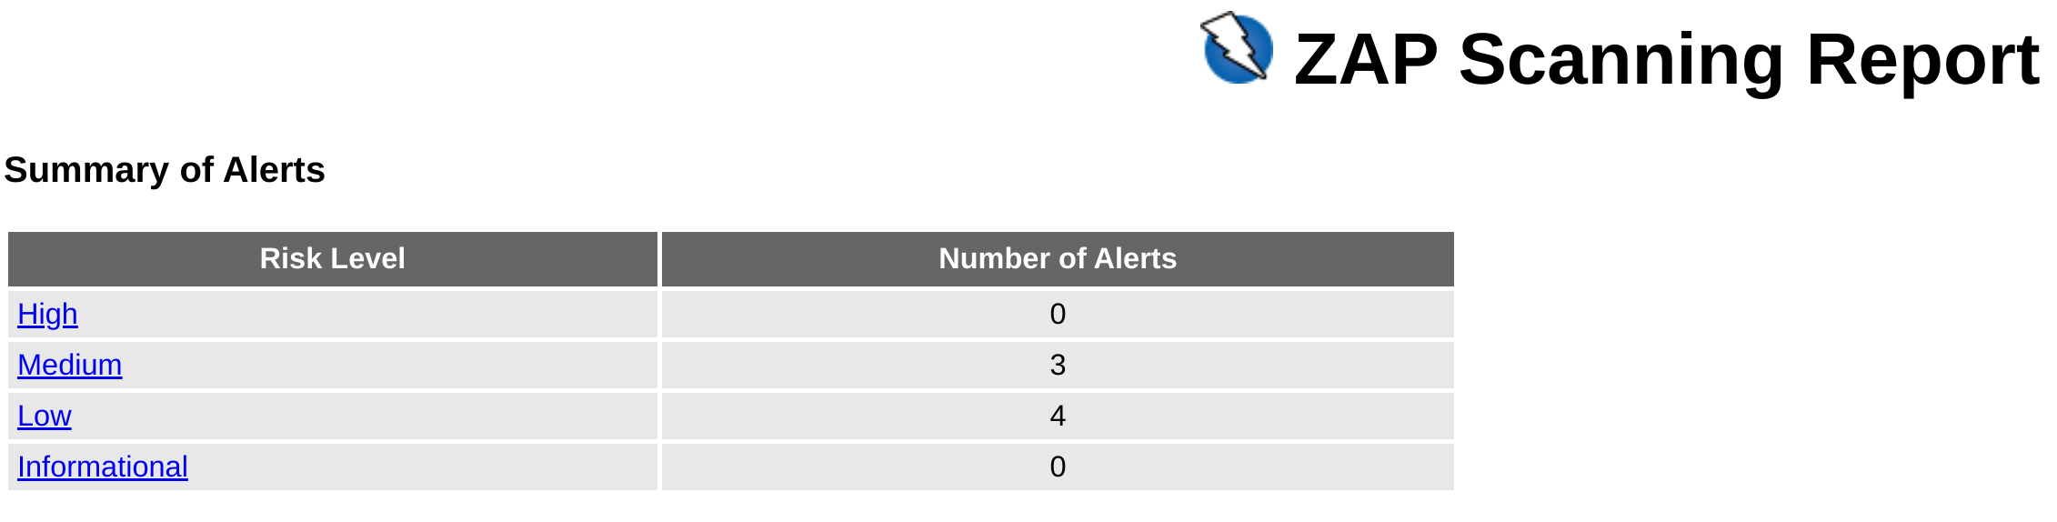
Demo : Zap report

Slide 62
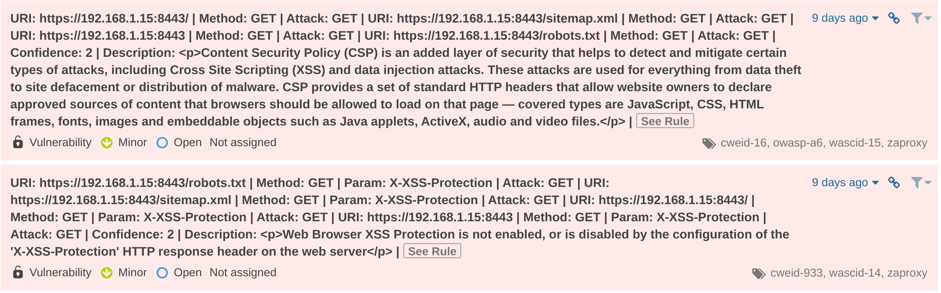
Demo : Zap issues

Slide 63
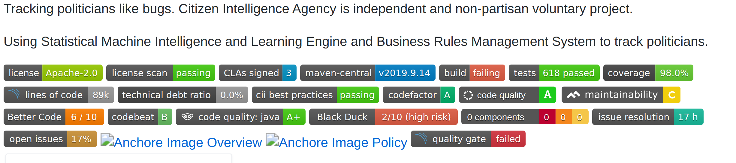
Demo: Badges

Slide 64
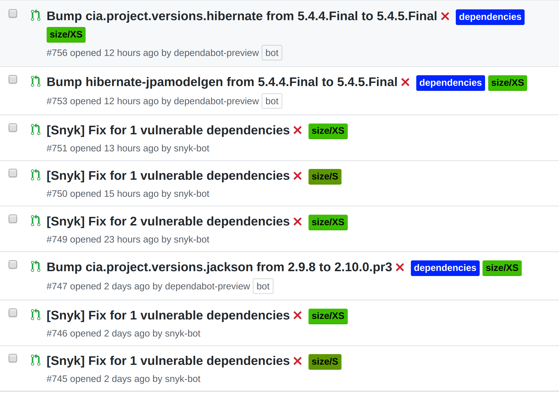
Demo: Bots

